Slide 1
DSA MINI PROJECT
Task Manager Project

Slide 2
Team Members
N S TUSHAR - PES2UG22CS327
MITHUN H R – PES2UG22CS313
NIHAL NOORAMMAD – PES2UG22CS354
NANDAKISHORE PRAMOD – PES2UG22CS334

Slide 3
C concepts used for the project
Structures .
Stacks using linked list.
Push operation
Priority Queue using linked list
Enqueue operation – for priority and dates
Dequeue operation – for priority and dates

Slide 4
Data Structures
The code employs several data structures to organize and manage task information:
Task: A structure representing a single task, including its description, priority, and deadline.
Queue: Two queues are used to store tasks based on their priority and deadline. The priority queue
Holds tasks based on their urgency, while the deadline queue holds tasks based on their due dates.
Stack: A stack is used to store completed tasks, providing a record of finished tasks.

Slide 5
Code Structure
The code is organized into several functions that handle specific tasks:
create_queue() and create_stack(): These functions initialize the priority queue, deadline queue, and completed
task stack.
create_task(): This function allocates memory for a new task structure and initializes its fields based on the
provided task description and priority.
enqueue_prio(): This function adds a task to the priority queue based on its priority level.
enqueue_DL(): This function adds a task to the deadline queue based on its due date.
push(): This function adds a completed task to the stack of finished tasks.
delete_queue(): This function removes a specific task from the priority or deadline queue based on its description.

Slide 6
delete_que_prio() and delete_que_DL(): These functions mark a task as completed by removing it from the
priority or deadline queue and adding it to the completed task stack.
display_pending(): This function displays the pending tasks from both the priority and deadline queues.
display_completed(): This function displays the completed tasks from the completed task stack.
change_date(): This function modifies the deadline of an existing task based on the provided new date.
change_priority(): This function modifies the priority of an existing task based on the provided new priority level.
Main Function
The main function serves as the entry point for the task manager application. It presents a menu-driven interface
that allows users to interact with the task manager's functionalities.

Slide 7
Task Manager Usage
The task manager provides users with various options to manage their tasks:
Adding Tasks: Users can add new tasks by providing a description, priority level, and deadline.
Viewing Pending Tasks: Users can view pending tasks from both the priority and deadline queues.
Marking Tasks as Complete: Users can mark tasks as complete by selecting them from the pending task list.
Changing Task Dates: Users can modify the deadlines of existing tasks by providing new due dates.
Changing Task Priorities: Users can adjust the priority levels of existing tasks by selecting new priority levels.
Exit Function: the function deletes all allocated memory space for the creating the queues and stack.

Slide 8
C source code for the project

Slide 9

HEADER FILES USED FOR THE PROJECT

Slide 10
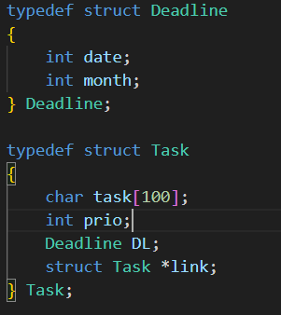
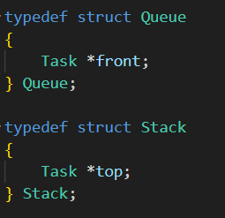
All the structures used for the project

Slide 11
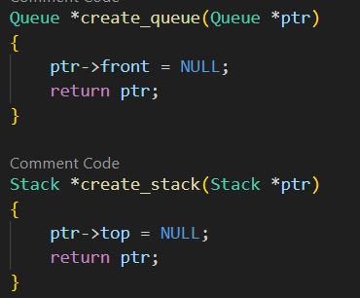
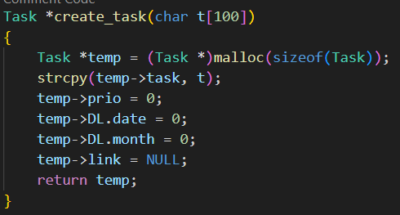
Creating the stack and Queue
And creating Tasks

Slide 12
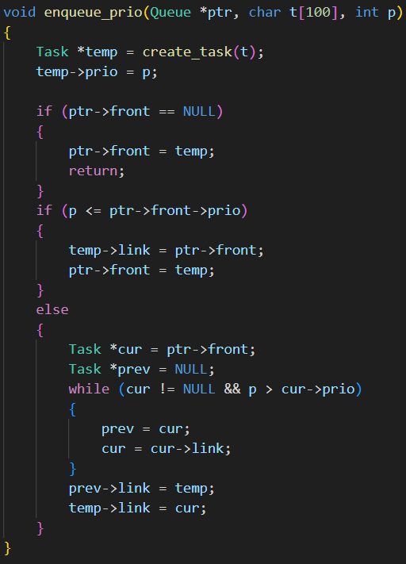
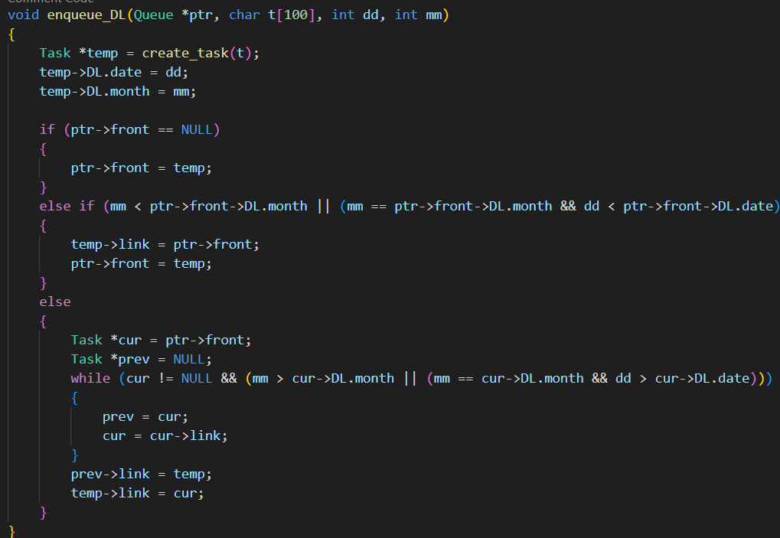
Insertion for the queue for priority and dates

Slide 13
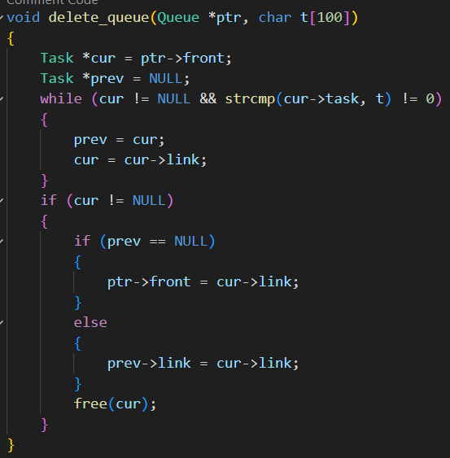
deletion for the queue

Slide 14
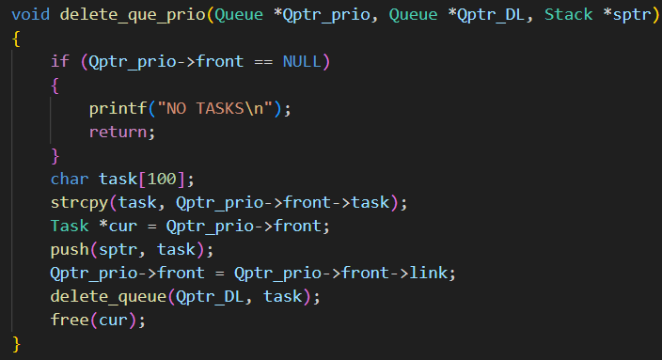
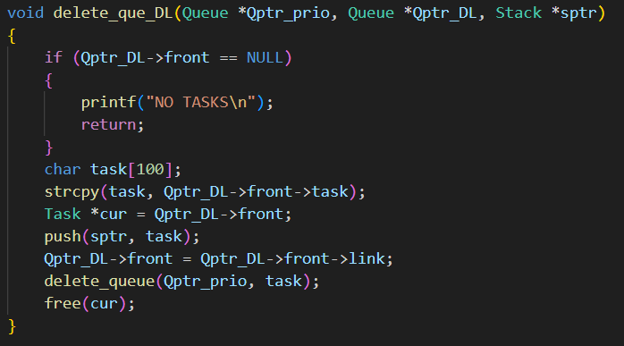
Deletion for deadline and priority in a Queue

Slide 15
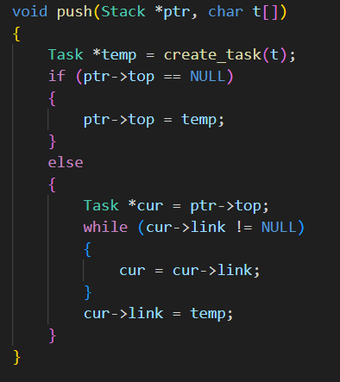
Stack insertion

Slide 16
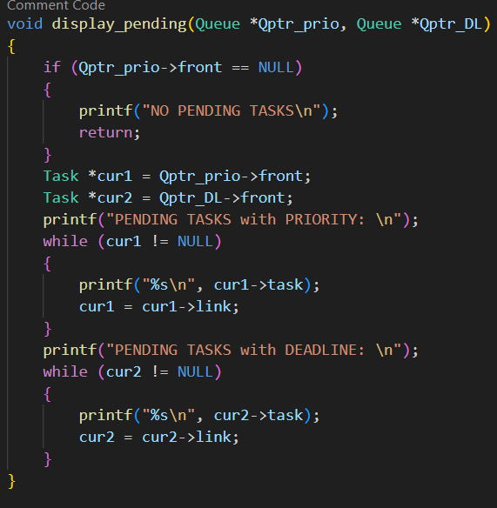
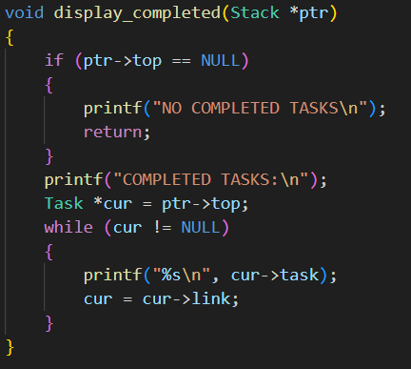
Display function
Pending task and Completed task

Slide 17
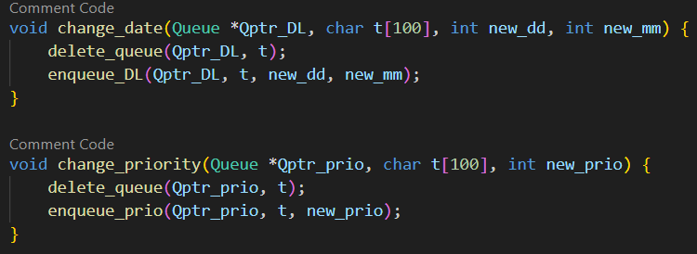
Change of deadline and priority of a given task

Slide 18
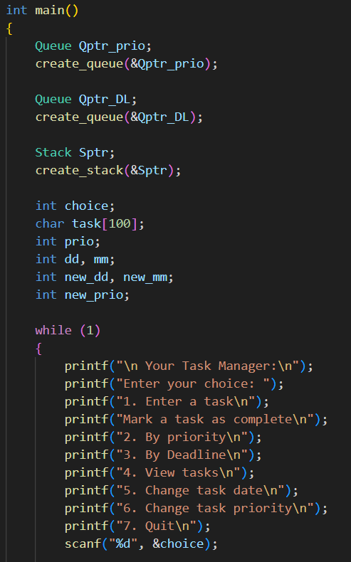
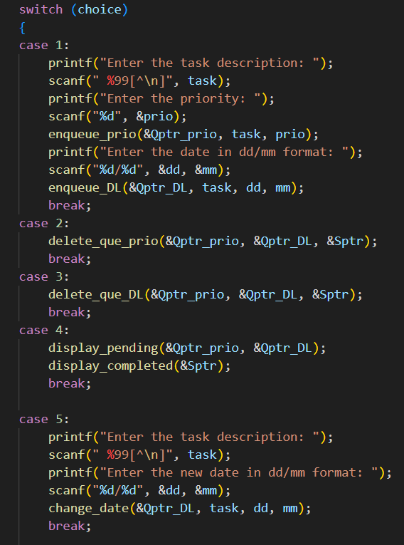
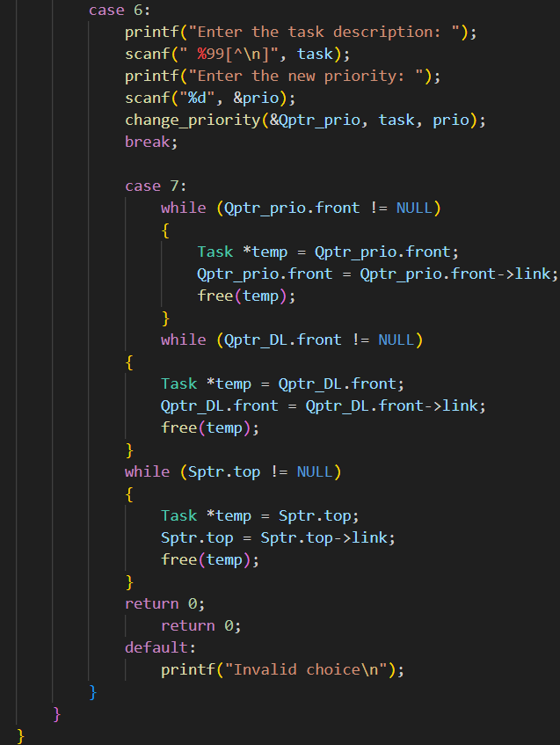
Main function

Slide 19
Code Output

Slide 20
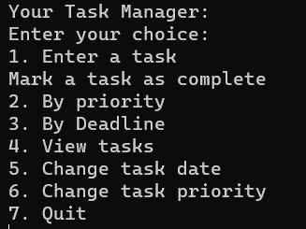
Menu option
THE INSERTION OF THE ELEMENTS INTO THE PRIORITY QUEUE FOR BOTH PRIORITY AND DEADLINE TAKES PLACE AT THE SAME TIME IN TWO DIFFERENT QUEUE

Slide 21
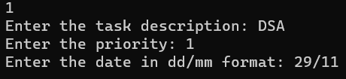
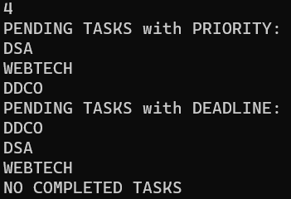
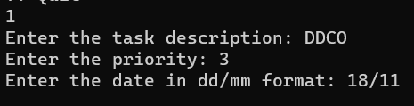
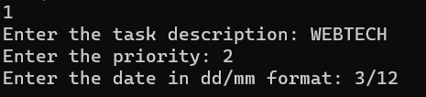
Insertion of tasks
Display

Slide 22
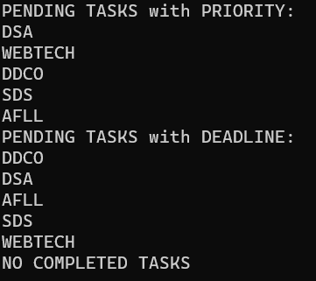
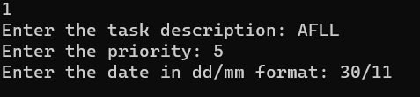

After insertion of few more elements
THE DISPLAY FUNCTION SHOWS THE PENDING TASK AND THE FINISHED TASKS

Slide 23
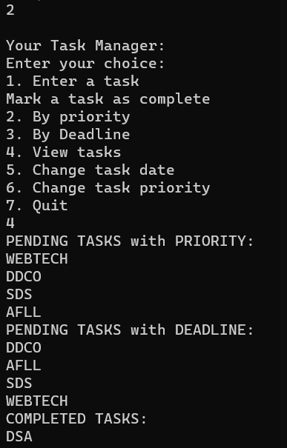
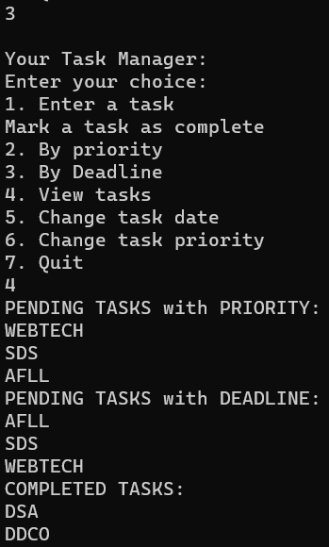
Completion of task by priority
Completion of task by deadline
THE COMPLETE FUNCTION
DELETES THE TASK FROM BOTH THE QUEUE FOR PRIORITY AND QUEUE FOR DEADLINE.
THE DELETED TASK IS THEN PUSHED INTO THE STACK TO KEPP A TRACK OF THE FINISHED TASK.

Slide 24

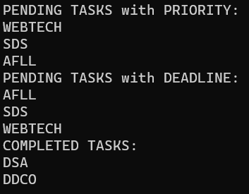
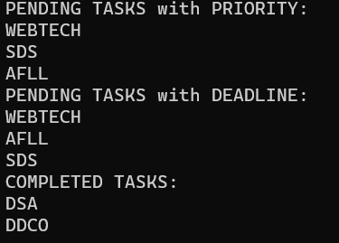
BEFORE CHANGING THE DATE
AFTER CHANGING THE DATE OF A TASK

Slide 25

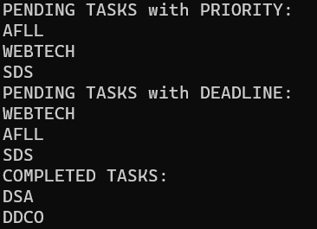
BEFORE CHANGING THE PRIORITY
AFTER CHANGING THE PRIORITY OF A TASK

Slide 26
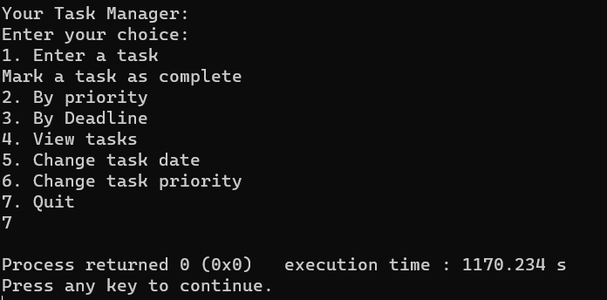
QUIT FUNCTION TO DELETE ALL THE NODES CREATED

